Slide 1




HackOrbit 2025
Team Name
CyberPunk

Slide 2

THEME & PROBLEM STATEMENT
Theme: Fintech Innovation
Problem statement: Due to a lack of knowledge and reliable online advice, millions of Indians still struggle to save money, lack access to individualized financial advice, and become victims of financial scams. A secure, AI-powered platform that provides low- and middle-income groups with individualized financial planning, budgeting, and intelligent investing is becoming more and more necessary.

Slide 3
PROPOSED SOLUTION
Product Name: FinGenius
Key Solutions:
1.✅ AI-powered chatbot for financial literacy & 24x7 support
2.✅ Smart budgeting tool based on real-time expense analysis
3.✅ Micro-investment suggestions based on risk appetite
4.✅ Scam detection alerts & secure digital vault for sensitive documents
5.✅ UPI-linked auto-saving feature that rounds up payments to save money

Slide 4
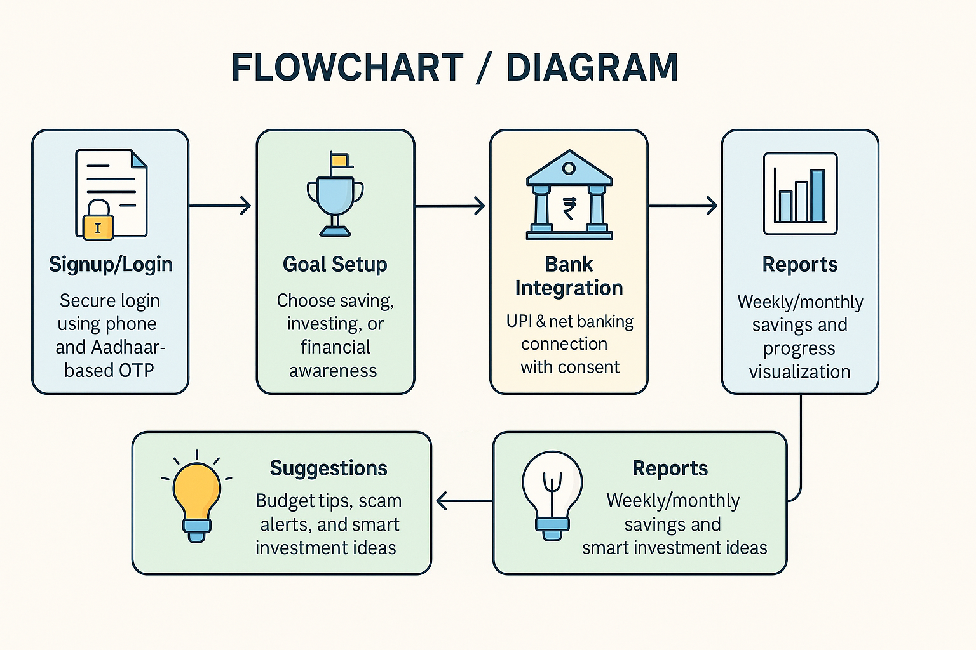
FLOWCHART / DIAGRAM

Slide 5
FLOWCHART / DIAGRAM
1.📝 Signup/Login: Secure login using phone and Aadhaar-based OTP
2. ⚽Goal Setup: Choose saving, investing, or financial awareness
3. 🏦Bank Integration: UPI & net banking connection with consent
4. 🧠AI Engine: Uses ML models to understand spending and habits
5. 💡Suggestions: Budget tips, scam alerts, and smart investment ideas
6. 🗒️Reports: Weekly/monthly savings and progress visualization

Slide 6
FEATURES AND NOVELTY
1.🧠 AI-powered voice & text chatbot in Hinglish & regional languages. 2.📊 Smart daily expense analyzer via SMS/UPI parsing. 3.💸 Micro-investing with as low as ₹10 per day. 4.🛡️ Fraud protection tips and scam alerts from verified sources. 5.🔐 In-app encrypted digital locker for PAN, Aadhaar, etc. 6.📱 Lightweight PWA (Progressive Web App) for rural smartphone users.

Slide 7
Tech Stack & Impact
🛠️ Tech Stack:
1. Frontend: React (PWA) – Fast, mobile-friendly interface
2. Backend: Node.js + Express – Scalable and lightweight
4.AI/ML: OpenAI API / Dialogflow – NLP chatbot
5. Database: Firebase / MongoDB – Real-time scalable data
6.UPI Integration: Razorpay / BharatPe API
🌍 Impact Potential:
• 50+ crore Indians lack personalized financial help
• FinGenius aims to impact 10M+ users in Tier-2 & rural India
• Empowering users with budgeting, micro-investing & scam protection

Slide 8
DRAWBACK AND SHOWSTOPPERS
1.⚠️ Data privacy risk — mitigated with strong encryption and consent-based sharing 2.⚠️ AI bias — addressed using diverse training data and feedback loops 3.⚠️ Regulatory hurdles — follow RBI sandbox & data compliance guidelines 4.⚠️ Low internet areas — app supports offline caching of key features

Slide 9
TEAM NAME
Team Name: CyberPunk
Member:
Name: Kanishk Kumar (MMH College) Email: [Kanishk6106@gmail.com] Phone: [7217753170]

Slide 10
Thank you

